Slide 1



Wake ThreeSchool Director’s Onboarding

Slide 2

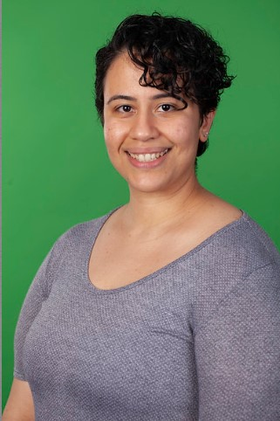
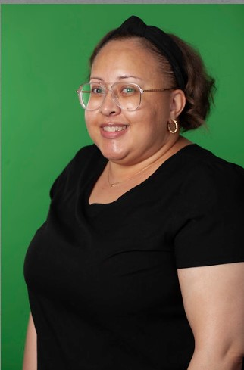
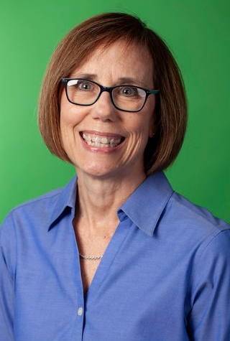
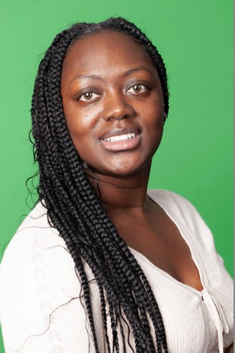
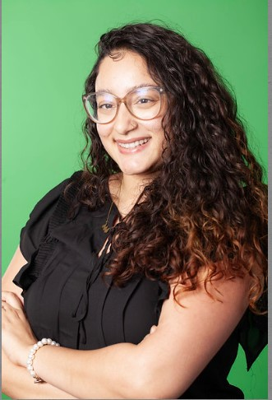

WCSS Wake ThreeSchool Staff
Melissa Radice Peguero
Wake ThreeSchool Application Systems Coordinator
mradice-peguero@wakesmartstart.org
(919) 723-9298
Gina Soceanu
Social Emotional Learning Specialist (SEL)
gsoceanu@wakesmartstart.org
919-723-9294
Emily Diaz
Wake ThreeSchool Program Assistant
EDiaz@wakesmartstart.org
984-480-3725
Taylor Young
Wake Three School Manager
tyoung@wakesmartstart.org
919-723-9277
Natasha Williams
Wake Three School Specialist
nwilliams@wakesmartstart.org
984- 480-3728
Kinrecka Anderson
Wake Three School Enrollment Coordinator
kanderson@wakesmartstart.org
919-723-9300

Slide 3


Director/Designee/Admin Introductions
Please provide a short introduction
Name
Site
Title

Slide 4
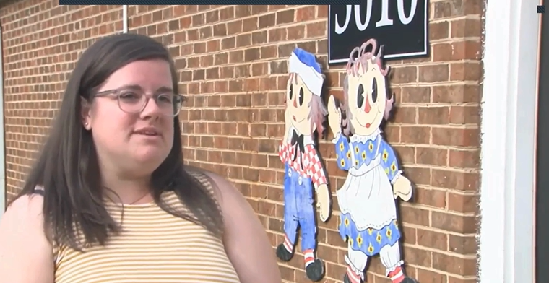

Wake ThreeSchool
Hear from a former Wake ThreeSchool Parent
Wake ThreeSchool sites provide the Wake ThreeSchool program for 180 regular school days (e.g., 6.5 hours) per WCPSS traditional school calendar year.
Wake ThreeSchool is a program that provides early education to three-year-olds in a play-based, dynamic environment, similar to NC Pre-K.
We prioritize children who have never been in childcare and fall within 75% of the State Median Income.
Our classroom ratios are 1:8, with a maximum of 16 children in a classroom.
Wake County Commissioners Fund Wake ThreeSchool
We use Creative Curriculum as a Curriculum for our classrooms and Brigance Early Childhood Screening for assessment data.
Wake County Social Emotional Learning Projects train and coach teachers to set up emotionally rich classrooms for children by reinforcing teaching practices that support children using the Pyramid Model as its foundation. The project was created 7 years ago and is now expanding its work with WTS and NC Pre-K.

Slide 5


WTS SY24-25 Form Submitting
We will provide all forms digitally via Adobe. This will help with a smoother process of submitting information.
The expectation is that we receive these forms typed and electronically.
Forms submitted to BridgeCare for Contracting Paperwork
WTS Contract Updates,
WTS Compensation Staff Information and
Compensation Form,
WTS Compensation EOY Confirmation and
WTS Substitute Staff Information and Confirmation Form)

Slide 6

Family Intake and Engagement
Connecting with families initially – site orientation
WTS Behavior Support Plan for SY24-25
Discussion on “unique” strategies for connecting with families during the year – why and how do you choose family engagement activities?

Slide 7










Welcome to Frankie Lemmon School
Admissions & Enrollment for
Wake Three School (WTS) & NC Pre-K (NCPK) Families

Slide 8









Process for Enrolling
Schedule a visit to the school by choosing a day/time at this link: Calendar Booking
When you come to visit, be sure to bring your completed forms (sent to your email)!
Parents Complete Enrollment Forms sent by email
When you visit the school, you will have a family intake meeting & your child will participate in a brief play session with a teacher.
Parents & Children
Visit the School

Slide 9


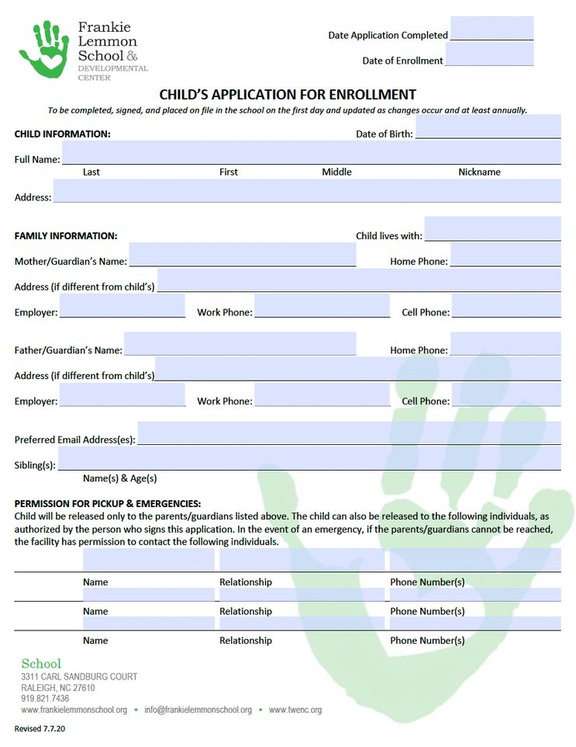
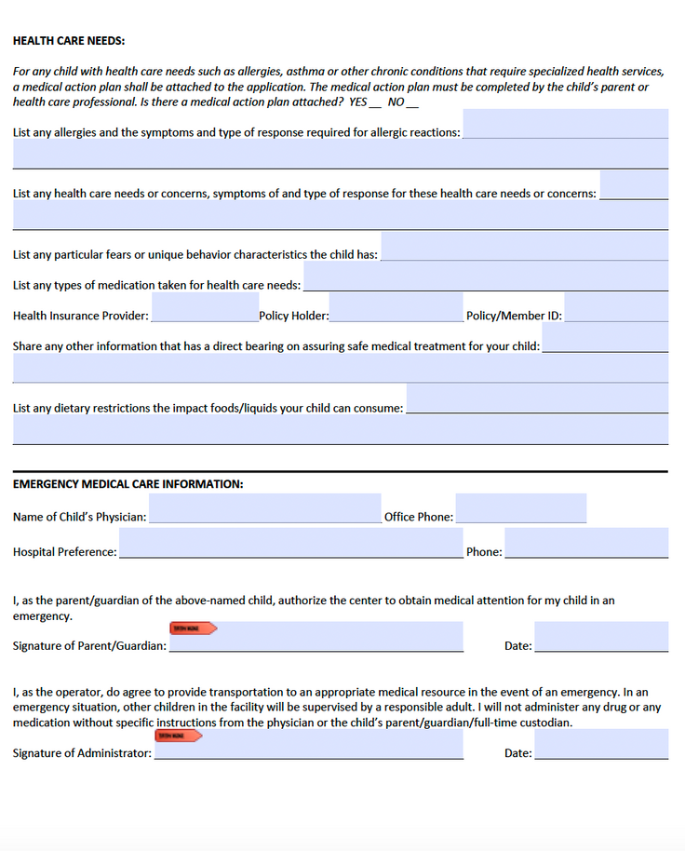

Form #1
Application
for Enrollment

Slide 10
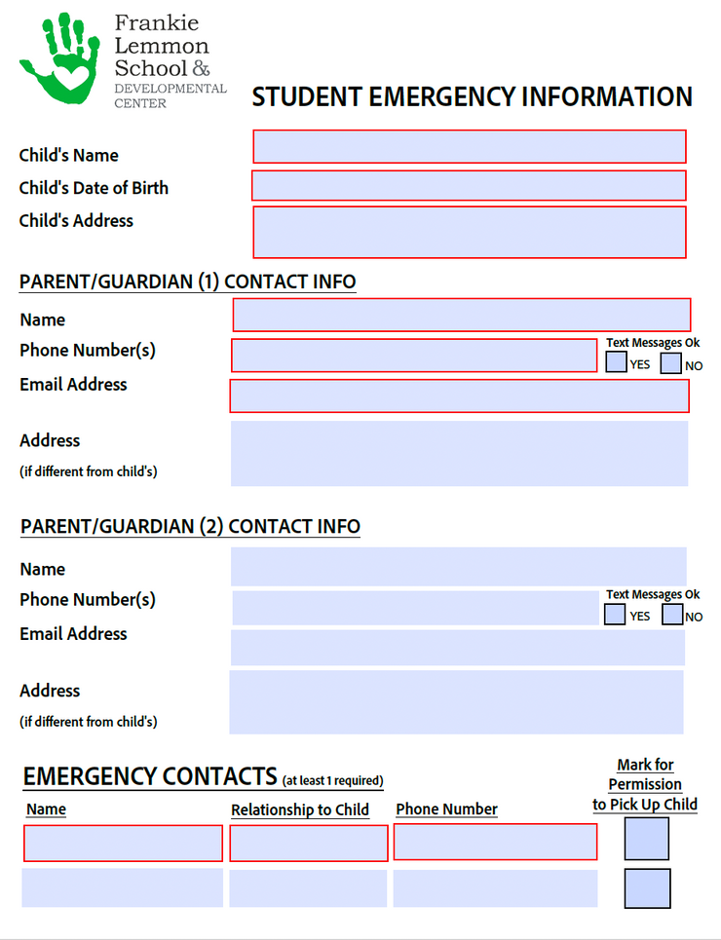
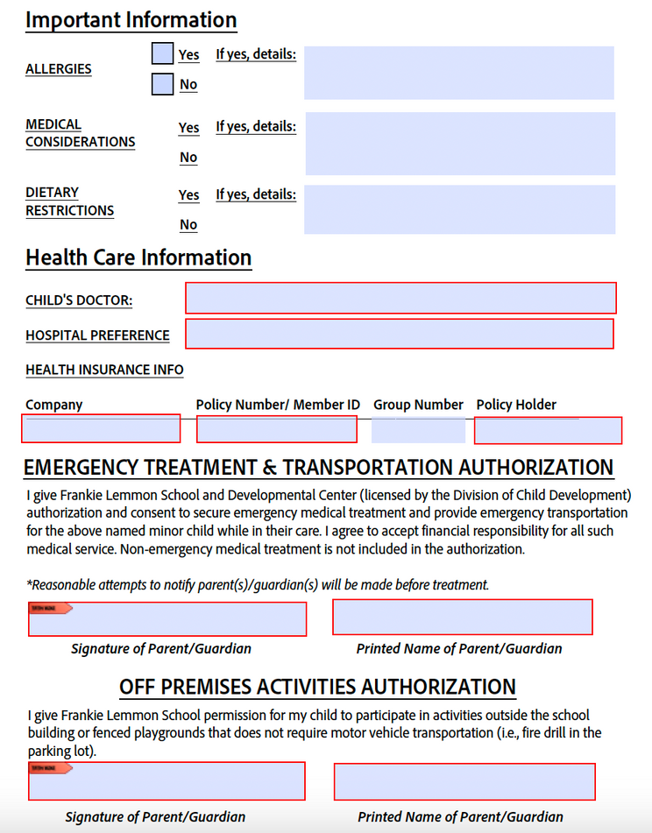
Form #2
Emergency
Card

Slide 11
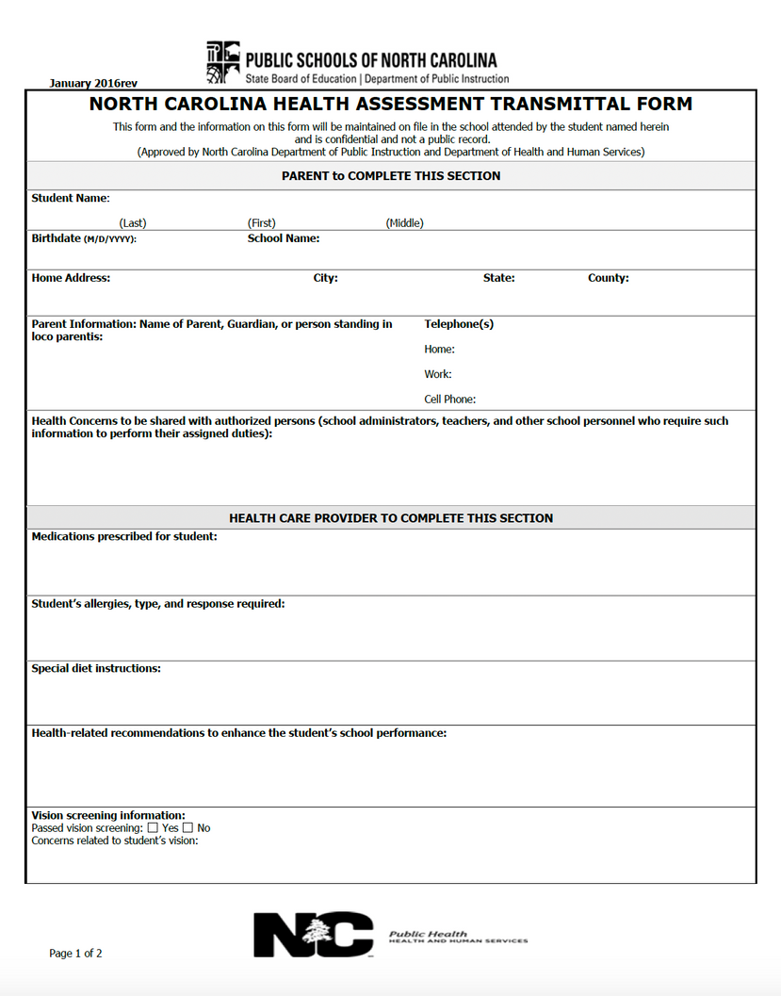
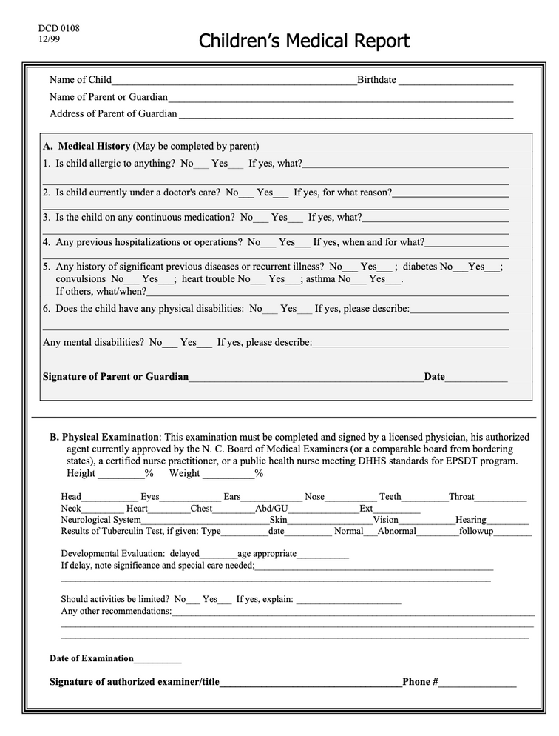
NCPK
Form #3
WTS
Physical & Immunizations
Due back by September 5th
Must be completed by a physician & is valid for 1 year from date of exam.

Slide 12






Our Program
Family Orientation
Thursday, September 5th, 1:00-2:00pm
School Schedule
School Calendar
Monday-Friday, 9:00am-3:30pm
will be given out at Family Orientation
Morning Drop-Off
Afternoon Pick-Up
Drop off: 8:55am-9:15am
Pickup: 3:15pm-3:35pm
1st Day of School
Friday, September 6th

Slide 13



Helpful Info for Families
Attendance
Children’s regular attendance at school is important for their growth & development. Families are asked to ensure children come to school every day they are healthy. *Please let us know if your child has any medical conditions or needs medication at school (inhaler, epi pen, etc.).
Meals
Transportation
Breakfast, Lunch & Afternoon Snack are provided daily. A menu is available on our website, our Family Board & posted in your child’s classroom. *Please let us know if your child has any allergies or dietary restrictions!
Children’s transportation must be provided by parents or other adults parents designate. No school transportation is available. *If you need assistance with bus routes, please let our Outreach Coordinator know & she is happy to help!

Slide 14





Helpful Info (continued)
Teachers
Wrap Around
Teachers will contact your family in mid-late August to schedule a home visit as a way to get to know you & your child before school begins. They will also provide information about your child’s classroom, and can answer any questions you might have.
If your child needs before-school (8am-9am) and/or after-school (3:30pm-4:30pm) care, please ask for a Wrap Around Care form to submit your request. *Subsidy vouchers are accepted. Space is limited & first-come, first-served.
Need for School
Your child will need:
  A backpack to carry their communication folder in (this will have a daily note for you to get information about your child’s day).
  A full change of clothes that can be kept in the classroom in the event they need to change.
  Optional: If they have a favorite stuffed toy or blanket (lovie) they would like to have during rest time, they can bring one.
All other supplies & materials will be provided by the school (including a sheet & blanket for their rest mat).

Slide 15


Thank You!
We are looking forward to a wonderful school year!
If you need assistance before your visit to the school,
please contact our Admissions Coordinator, Suzannah Harrelson at: suzannah@frankielemmonschool.org

Slide 16
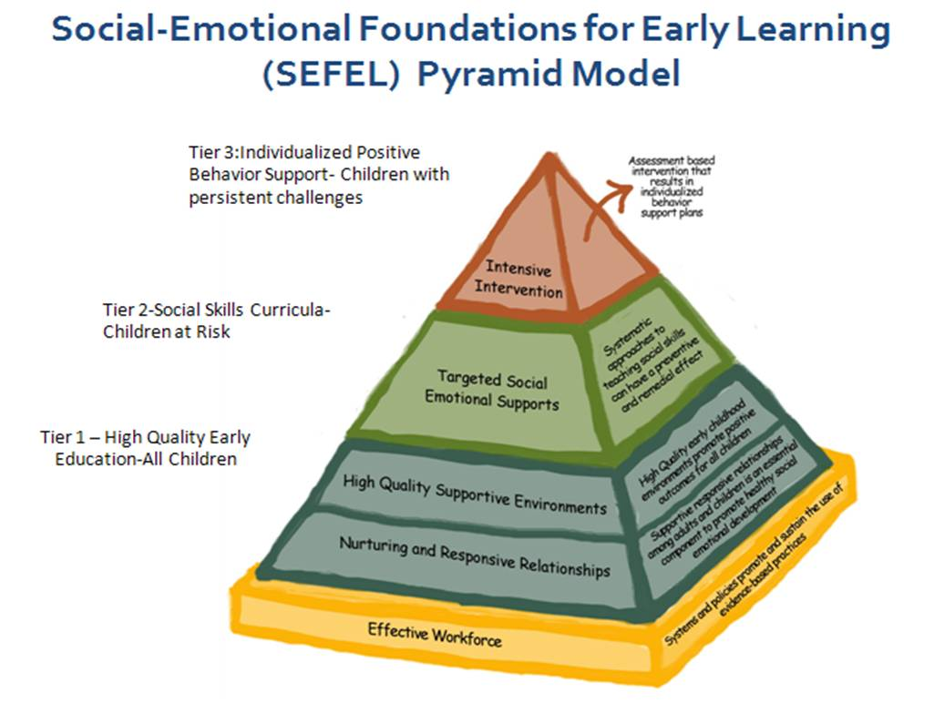

Social Emotional Learning (SEL) Expectations
SEL is an integral part of the classroom experience
SEL Specialist/Coach will visit classrooms on a regular basis. A pre-TPOT (Teaching Pyramid Observation Tool) will be completed on each new classroom or as determined by WTS
SEL Specialist/Coach will complete a random selection of post-TPOTs at the end of the school year
Is available for support with Room Arrangement and will complete a modified ECERS materials assessment if funding is available to purchase materials.

Slide 17
Challenging Behaviors and Behavior Support Plan
What does coaching look like, adjustments based on last year’s challenges
  focus on foundational skills (the first 6 weeks) building relationships with children and families
  visits will begin immediately, pre-TPOTs will occur but contracted out so that I can be available
Beginning documentation on children, communicating with families
  WTS ABC Behavior Chart
  WTS Early Childhood Behavioral Engagement and Developmental Needs Report
Alert SEL Specialist immediately
SEL Teacher PD – schedules, classroom management, large group/small group, routines, transitions
Potential agencies that can support individual children's behavior during the year e.g. speech, OT, etc.
Remote Learning Behavior Plan

Slide 18

Al’s Pal SEL curriculum
Al’s Pals Project
- Teaching Strategies evidence-based SE curriculum
- Complements Creative Curriculum and aligns with goals/objectives
- Pilot Sites SY24-25: Frankie Lemmon, Wakefield Creative School
- SEL Specialist will support sites in implementing curriculum
- Goal to expand sites in SY25-26

Slide 19
Application Process
Application is available Online and on Paper
Will take about 4-6 weeks for applications to be fully processed.
We encourage our families to complete an application online; paper applications are available on our website along with the online application at https://threeschool.wakesmartstart.org/
Families are welcome to our office for further assistance with the application process or families may reach out to Emily Diaz
  By Phone: 984-480-3725
  By Email: ediaz@wakesmartstart.org

Slide 20
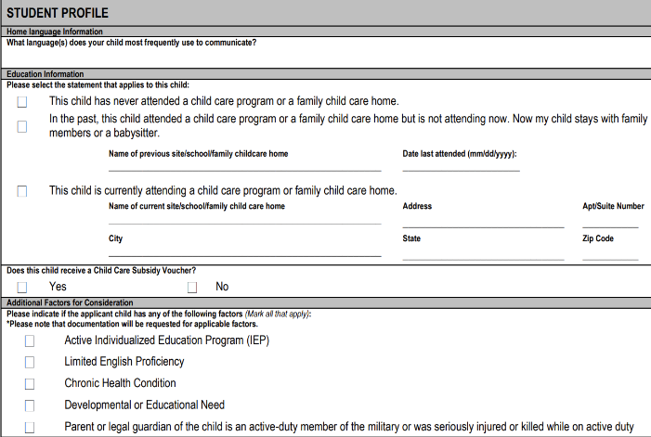

Child Eligibility Criteria
Wake ThreeSchool is prioritized for families with low incomes and below the 75% State Median Income and the following priority groups:
  Children with documented health or learning issues
  Children with Individualized Education Programs (IEPs)
  Children that speak a language other than English at home
  Children with parents/guardians who are active-duty members of the armed forces

Slide 21
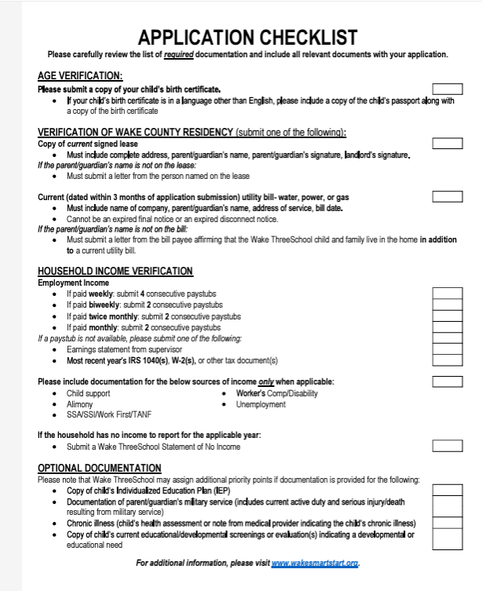
Documentation needed to complete an application

Slide 22

Transportation and Resources
GoWake Access, which is housed within WCHHS. They have a door-to-door service however, you have to call in advance to reserve a ride each day.
It's first come-first serve. GoWake Access provides door-to-door, shared-ride transportation service to those who are age 60 or older, disabled, need work-related transportation, reside in rural service zones of Wake County, or participate in a sponsored eligible service (Medicaid, Public Health, Work First)
https://www.wake.gov/departments-government/health-human-services/programs-assistance/gowake-access-transportation.
GoWake Access Call Center (919)-212-7005 - to reserve a trip
GoRaleigh Access is similar, and their eligibility requirements are listed on their website
https://raleighnc.gov/go-raleigh-access
Call Center (919) 996-3459 – to reserve a trip
Turner Pride
turner.pride@wakegov.com
919.856.6614 office | 984.301.2186 cell

Slide 23


Childcare resources in Wake County
Provider's, please encourage families to apply to these additional resources if wrap around care is needed in addition to providing them with the 6.5-hour Wake ThreeSchool School day.
Child Care Service Association
CCSA helps families find childcare and assistance with the cost for those who qualify.
Their website https://www.childcareservices.org/families/
Phone number: 1-888-6000-1685
Website: https://www.childcareservices.org/
Wake County Human Services
Wake County Human Services assist families with applying for childcare vouchers assistance with finding quality child care.
Phone Number: 919-212-7000 or 919-212-9285
Website: https://www.wake.gov/departments-government/health-human-services

Slide 24

Updated Reimbursement & Classroom Rates
FY2023-2024
FY2024 – 2025
Lead Teacher Education Level | Per Slot Reimbursement Rate
Fully Qualified: BA/BS in early childhood education/child development or a related field | $1228
Long-term Substitute Lead Teacher | $785
Lead Teacher Education Level | Per Slot Reimbursement Rate
Fully Qualified: BA/BS in early childhood education/child development or a related field *related fields: human development, family studies, psychology | $1275
Long-term Substitute Lead Teacher | $810

Slide 25
COMPENSATION FOR INSTRUCTIONAL STAFF- LEAD TEACHERS

Slide 26
COMPENSATION FOR INSTRUCTIONAL STAFF- TEACHERS ASSISTANTS

Slide 27

WTS Classroom Support Needs- Next Steps
 | Unserved | Underserved | IEP/Developmental Need identified at time of application | # of High Need Children | Teacher Turnover
SY22-23 | 72% of enrolled children 122 children | 21% of enrolled children 36 children | 30% of enrolled children 50 children | 78% of enrolled children 131 children | 4 Teacher 3 LT & 1 TA’s
SY23-24 | 76% of enrolled children 145 children | 12% of enrolled children 23 children | 5% of enrolled children 10 children | 84% of enrolled children 161 children | 10 Teachers 6LT’s & 4TA’s
SY24-25 | 58% of eligible applications received 407 children | 12% of eligible applications received 86 children | 12% of eligible applications received 82 children | 31% of eligible applications received 136 children | N/A
 | # of sites | # of classrooms | # of teachers
SY22-23 | 8 sites | 8 classrooms | 14 teachers
SY23-24 | 15 sites | 16 classrooms | 30 teachers
SY24-25 | 19 sites | 24 classrooms | 45 teachers
Notes:
Chart on the left highlights additional factors that directly impact classroom support
Increased number of acute challenging behaviors with multiple children in nearly every classroom
Chart on right highlights the increased capacity to support the number of sites, classrooms, and teachers
Number of new WTS sites entering the program needing more intensive quality support to include sites that do not currently have NCPK
Support the goal of training teachers on CLASS and coaching these practices post-training
Supporting SEL work, CLASS coaching, ECERS, DAP, and/or curriculum

Slide 28
Years of Experience and Compensation for 24-25
Years of experience is defined as the number of years of experience working with preschool children (3- and 4-year-olds), not specific to only the number of years of experience working directly at your site
Years of experience should reflect the teacher’s experience working with preschool children prior to working at your WTS site AND years of experience working with preschool children at your WTS site

Slide 29


Break for Lunch
Lunch will be provided by Wake ThreeSchool

Slide 30

Parent Accepting & Declining of Slot 24-25 SY
Families receive a text message notifying that they have an email with their placement. The email contains the following:
  The deadline for when they must respond to their placement notification (families have 5 business days).
  Instructions on how to accept/decline placement.
  Link to application portal where they will accept/decline placement.
    Families that declined are prompted to complete a quick survey of why they are declining placement and are placed at the bottom of our waitlist.
    Families that do not respond within the deadline are placed at the bottom of our waitlist.
Providers are to reach out to families within 5 business days of placement being offered to answer any questions and to encourage families to respond to their placement within the timeline.
  Sharing next steps (start date, family orientation, site orientation, home visit, etc.)

Slide 31

Data & Numbers of Applications
SY 22-23 (Pilot Year)
  Slots 100
  Submitted Applications 986
SY 23-24
  Slots 200
  Submitted Applications 1,047
SY 24-25
  Slots 305
  Submitted Application 824

Slide 32

Attendance Policy
Attendance must be taken daily, entered on a weekly basis, and submitted in BridgeCare on the last school day of each month by noon.
If a child is absent, it is the site administrator’s responsibility to contact the family.
Attendance designees are responsible for notifying the WTS Enrollment Coordinator when a child has missed 3 or more days.
Site administrators are responsible for notifying WTS Enrollment Coordinator of any excessive absences.
If a child misses 5 or more consecutive days, please notify the WTS Enrollment Coordinator. If multiple attempts have been made to contact the family and has been unsuccessful, the site administrator should send a final contact to the family indicating that they will need to inform the site of their decision regarding their child’s participation in the program
If a child misses 10 or more school days within a month, he/she could potentially forfeit his/her slot in the program

Slide 33

Attendance Submission
Attendance Exceptions
Exceptions for an individual child’s attendance can be requested for certain conditions such as:
  Illness, hospitalization, military leave, a family emergency, crisis requiring family travel, or
  For natural disasters such as hurricanes, tornadoes, flooding, or
  Other conditions that require the Wake ThreeSchool site to close due to damages (i.e., fire, water, damage, loss of heating/air, etc.).
Extended Family Vacation
Each WTS child is eligible for excused absences for up to five (5) consecutive school days for an extended vacation. Each child is eligible for one (1) extended family vacation per WTS school year. Written notice should be provided to the WTS site at least one week in advance, noting the beginning and end dates of the child’s vacation-related absences.
Any vacation-related absences that persist longer than five days will jeopardize the child’s continued enrollment in the Wake ThreeSchool classroom.
Wake ThreeSchool Enrollment Coordinator should be informed of any attendance exceptions in writing.
If the Wake ThreeSchool classroom must close for any reason (including but not limited to those listed above), the Site Administrator must inform the Wake ThreeSchool Enrollment Coordinator as soon as the decision has been made to close the classroom.

Slide 34


Rolling Enrollment & Ongoing Enrollment
Rolling Enrollment Dates Are:
6/28
7/12
7/26
8/9
8/23
Ongoing Enrollment
Any slots that are open will be filled on an ongoing basis every Friday
Slots will be filled throughout the year until the end of March 2025

Slide 35

Wake ThreeSchool Remote Learning
Remote Learning
Remote learning instruction must be requested by the WTS provider. The WTS Remote Learning form must be completed, submitted, and approved by the WTS staff, prior to remote learning being offered. The remote learning period must not exceed 2 consecutive weeks. Please contact the WTS Enrollment Coordinator or the WTS Specialist if additional remote learning time is needed.
Upon approval, WTS teachers should provide short direct instruction and provide activities and learning opportunities for children and families to engage in independently that total approximately 6.5 hours of available material daily for a remote learner/family. When possible, lead teachers or teacher assistants should offer blocks of live, direct remote instruction at least once per day if remote learning is being provided to an individual child or twice per day if remote learning is being provided to all children.
Family/Child Check-ins
Family check-ins are opportunities for teachers to connect with families via home visits, phone calls, video conferences, etc.
Individual Child: Learning instructions should be provided to the child via Teaching Strategies Family Portal. Activities should be provided to the child based on the current lesson being received in the classroom environment.
Entire Class: Learning instruction should take place twice per day with live instruction. Current Lesson Plan can be used to help teachers and or administrators incorporate live instruction.

Slide 36
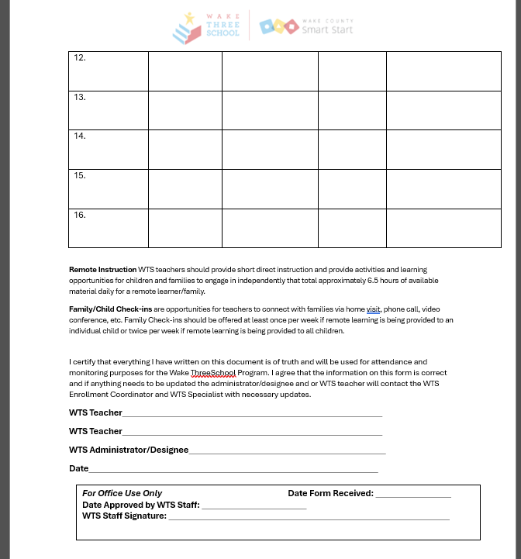
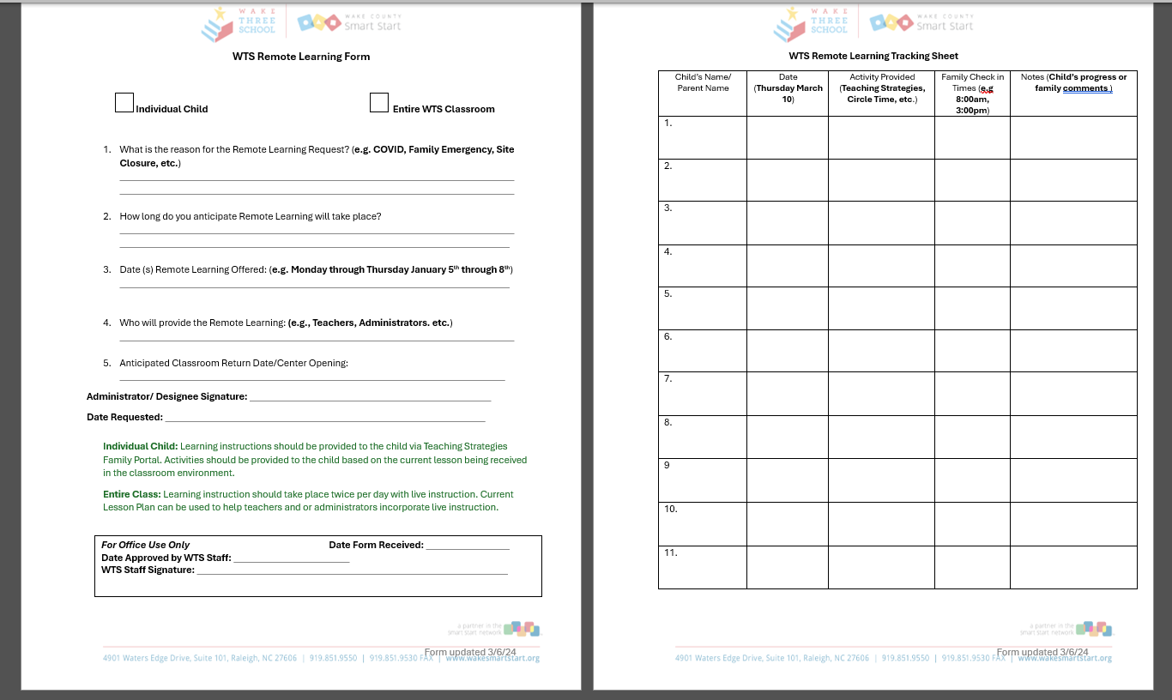
Wake ThreeSchool Remote Learning Form

Slide 37
Child Health Assessments
Health assessment is required to be on file at the WTS site within 30 days after a child enters WTS Program and must have been completed within 12 months of Program entry.
If a child’s health assessment is not completed within 30 calendar days or an appointment has not been made or has not been kept for the health assessment, the WTS site administrator will notify the family that the child will lose his/her WTS placement unless there are extenuating circumstances. The site administrator will copy Local Partnership (Wake County Smart Start) on this communication. Sites must report to the WTS Specialist the completion of health assessment during mid-year monitoring.
The health assessment must include:
  Physical examination
  Updated immunizations
  Hearing screening
  Vision screening
Sites must report to the WTS Enrollment Coordinator and WTS Specialist the completion of health assessment during mid-year monitoring.

Slide 38

Family Orientation
Will take place via Zoom on
Wednesday July 31st 10:00-11:30am English
Wednesday July 31st 10:00-11:30am Spanish
Wednesday July 31st 1:00-2:30pm
Wednesday July 31st 1:00-2:30pm
As you communicate with your families encourage them to sign up for a session to learn more about WTS and its Family Expectations
Will take place via Face to Face on
Monday August 26th 10:00-11:30 am English
Monday August 26th 1:00-2:30 pm Spanish
Location: TBA

Slide 39


Creative Curriculum & NC Foundations
Wake ThreeSchool classroom shall use the Creative Curriculum® for Preschool, 6th Edition as well as use of the Pyramid Model to address the social emotional health of the young children in the program.
WTS Sites shall be knowledgeable about Foundations: Early Learning Standards for North Carolina Preschoolers and Strategies for Guiding Their Success and use these early learning standards to guide their planning of developmentally appropriate, high-quality prekindergarten experiences for children.
Formative Assessments
WTS Sites are required to conduct ongoing formative assessments to gather information about each child’s growth and skill development and inform instruction.
WTS Sites will use a formative assessment instrument approved by WCSS, such as Teaching Strategies Gold.

Slide 40
Teaching Strategies SY23-24 Data

Slide 41
Children Below Fall Winter Spring Checkpoints

Slide 42
WTS Children Exceeding Fall, Winter, Spring Checkpoint Data ​

Slide 43
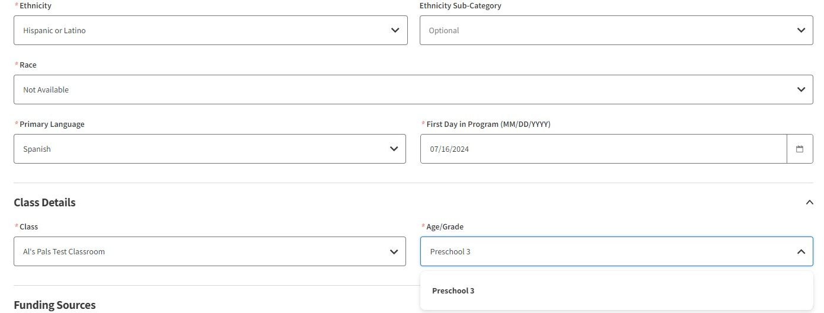
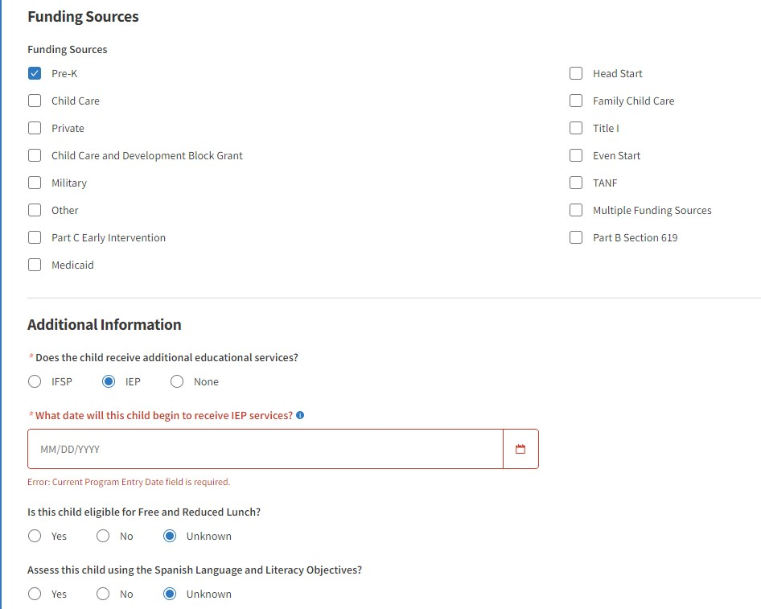
Teaching Strategies Guide
As you enter children into Teaching Strategies, please make sure you are choosing
Age group/Grade: Preschool 3
Class: WTS 24-25
Answer all questions needed in order to create the child’s profile account
Funding Source: Wake ThreeSchool/Other (in the process of having them add this back to Teaching Strategies) (applies to only Private WTS Sites)
Additional Information: Make sure to confirm this information regarding IEP/IFSP for (ALL) children you add into your Teaching Strategies system.
It is the site Admin or Teacher’s Responsibility to add children into their WTS classroom for Teaching Strategies. Please determine what will work for your site.

Slide 44
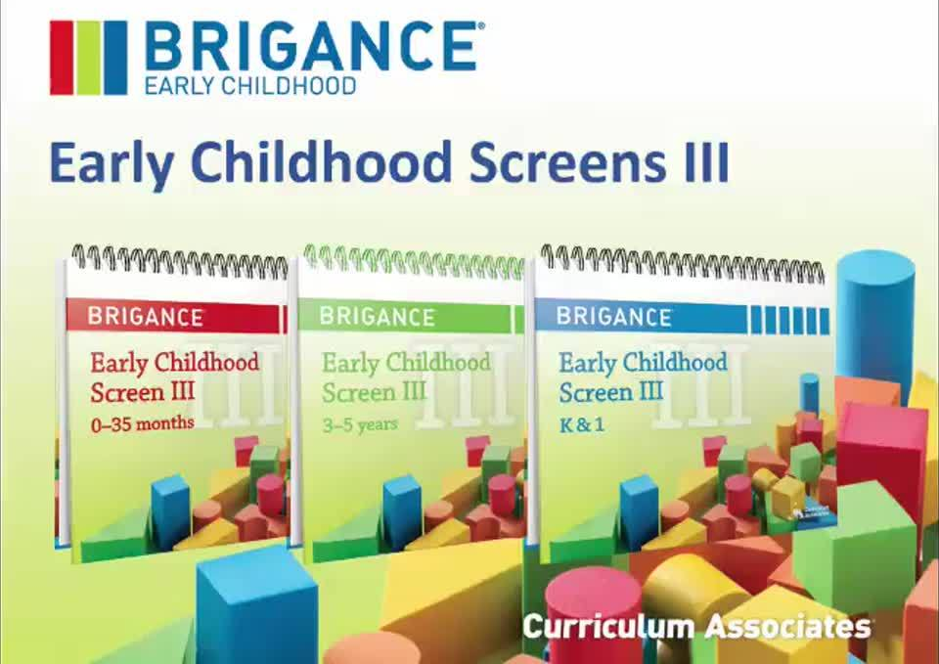
Developmental Screening
Developmental Screening Dates will take place at your Designated site on August 14th or August 20th.
Providers, please reach out to your families to set up a time on August 14th and August 20th to have their Brigance Screening completed.
If you are a site that is not interested in completing your Brigance Screening on the designated days, please send Natasha an email with your reason for not completing the assessment on the recommended dates.
All children enrolled in WTS shall receive a developmental screening using The Brigance Developmental Screening Tool unless the child has an existing Individualized Education Program (IEP).
Children shall be screened within 90 days after the first day of attendance in the Program or within 6 months prior to the first day of attendance.
Screening should be used to assist with finding any concerns and creating a baseline to help assist teachers and administrator on how to determine the overall growth and development of the enrolled child.

Slide 45

Brigance Screening Video
Please make sure you teachers complete the Brigance Training Link sent to you on July 19th. If you have any questions and are in need of a mock screening, please reach out to Natasha by August 14th.
https://cainc.zoom.us/rec/share/8BsOpiReMYDQKd_e4_OmsCfBrMm4KNbVysYqzipjck3ECMBnIonnVgxY8q7Dtuv_.lsTmjyrvOYeZPJut
Any Questions????

Slide 46
Professional Development Requirements & Instructional Staff Standard
Days set aside for home visits and for staggered entry at the beginning of the school year may be included as part of the school calendar year.
WTS staff will use the WCPSS Traditional School year calendar as guidance to determine the WTS professional development days for the current school year. Professional development days may not be used as optional attendance workdays.
It is the expectation that time is given to both the lead and assistant WTS teachers to plan together
WTS Classroom ratio is 1:8 with a maximum of 16 in a classroom
32.5 hours per week minimum of direct contact with children in the WTS classroom
7.5 hours per week minimum for planning, home visits, family conferences, PD activities, etc.
Planning time cannot occur when children are present in the classroom environment
Should take place outside the 6.5-hour day and are not to exceed 40 hours per week

Slide 47
Family Engagement
Parents/Guardians will sign a Rights and Responsibilities document at the time of application which explains how critical family involvement is to the success of their child and in signing agrees to be involved.
Sites are required to:
orient each family to the program when a child is assigned to their site
conduct at least 2 family conferences during the program year
offer at least 4 additional FE opportunities during the program year
provide updates on activities and objectives to families at least once per month
document all FE activities in writing and keep on file at the site
develop a FE plan in collaboration with WTS families
Family Engagement Plan

Slide 48
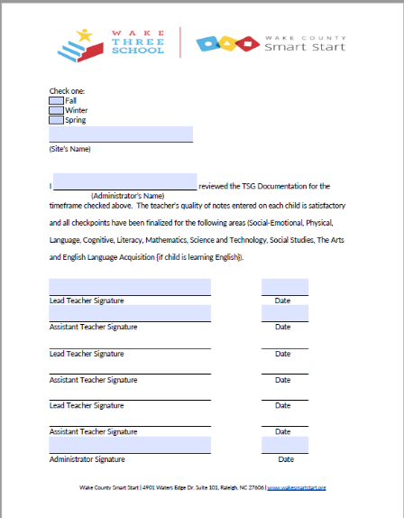
Teaching Strategies Checkpoint Due Dates
Checkpoint Period | Due Dates
Fall Checkpoints | Monday, November 04, 2024
Winter Checkpoints | Monday, February 17, 2025
Spring Checkpoints | Monday, May 26, 2025
Please note: Checkpoint Documentation Forms are Due for each Checkpoint period by 5:00 pm on the due date, the same form can be submitted for the correct checkpoint period.

Slide 49
Child Maltreatment Investigations
WTS sites must immediately notify WCSS of an open child maltreatment investigation or administrative action issued at the site.
The WTS site in question may continue operating the WTS classroom until the investigation and resolution are complete.
Wake ThreeSchool funds may be terminated where there is substantiation of child maltreatment that jeopardizes the health and safety of children enrolled in the program.
Wake ThreeSchool funds will be terminated when the participating WTS site facility license has been suspended or revoked. Any administrative action resulting in substantiation of child maltreatment or any administrative action resulting in as change of the license status may impact future participation of the Wake ThreeSchool program.

Slide 50
Lead Teacher/ Teacher Assistant/ Substitute Staff
Lead Teacher
All lead teachers must hold at a minimum a BA/BS degree in Early Childhood Education/ Child Development (ECE/CD) or a related field. Related fields include Human Development, Family Studies, and Psychology. In-progress degrees cannot be considered. A copy of the lead teacher’s DCDEE Verification Letter must be kept on file at the site and be made available upon request by WCSS staff.
Teacher Substitute for Short-Term Vacancies
15 days or less or fewer attendance days
Private Childcare/Non-Public School: Substitutes must have at least a high school diploma or GED, and some course work in ECE or Child Development (NC ECE Credential)
Public School: Must meet the requirements of the substitute policy consistent with the LEA
Teacher Substitute for Long Term Vacancies
16 or more attendance days
Regardless of setting: Substitutes must have a minimum of an AA degree
with at least 5 years in ECE/CD or a 4-year degree in a related field
Teacher Assistant
All teacher assistants shall hold at a minimum an AA degree in Early Childhood Education/ Child Development (ECE/CD) or a related field. Related fields include Human Development, Family Studies, and Psychology, In-progress degrees cannot be considered. A copy of the teacher assistant’s DCDEE Verification Letter must be kept on file at the site and be made available upon request by WCSS staff.
Teacher Assistant Substitutes for Short- & Long-Term Vacancies
Substitutes for teacher assistants must be at least 18 years of age and have at a minimum of a high school diploma or a GED.

Slide 51


Director’s Meeting & Participation
Director’s Meetings are every other month on the third Wednesday from 12:00-1:30 pm via Zoom and/or Face to Face at the Wake County Smart Start Office. Please check the dates and location for each meeting.
Wednesday 7/17/24 Director’s Onboarding Meeting
Location: WCSS Office Training Room
Wednesday 9/18/24 Director’s Meetings
Location: WCSS Training Room
Wednesday 11/13/24 Director Meetings
Location: Zoom
Wednesday 1/15/25
Location: WCSS Training Room
Wednesday 3/19/25 Director’s Meeting
Location: Zoom
Friday 5/2/25 Director’s Feedback Session
Location: WCSS Training Room
Time: 9:00-10:30
Wednesday 5/14/25 Director’s Meeting
Location: Zoom
Please note: A Director or Designee must attend Director’s Meetings & Scheduled Professional Development

Slide 52


How can you help your teacher’s?
Creating a Culture of Support for Teachers is Vital to Student Success https://www.tasb.org/news-insights/creating-a-culture-of-support-for-teachers
Complete Quarterly Classroom Observations https://propello.com/blog/conducting-effective-classroom-observations
Supporting Families with Effective Family Engagement https://www.naeyc.org/resources/topics/family-engagement/principles

Slide 53
Site Monitoring
Site Monitoring Timeline FY24-25 School
When | What | Who
By October 31st | An original copy of the Site Tool is completed and plans for items that require an Action Plan must be submitted to WCSS. (Site or classroom new after October 1, should complete and submit within 90 days of the first attendance day.) | Site administrator or designee (site director or designee) *All child developmental screenings not completed by October 31 should be noted in the Action Plan.
December -February | Conduct site visits to review and discuss Site Tool and results. Schedule follow-up visits as needed. | WCSS (or designee)
February - May | WCSS staff discuss/review Site Tools and monitoring results with site director and/or designee. If a particular standard or requirement has not been met based on monitoring, a written plan to meet compliance must be completed. | WCSS
By June 30th | Monitoring results reported to the Board of Directors annually. | WCSS (or designee)
Monitoring by WCSS
WCSS staff will monitor for compliance with specific WTS Program requirements.
Monitoring Tool
Monitoring tool(s) developed by WCSS must be used at the site level for self-review and verification of compliance with the operating requirements.
WTS Site Monitoring Tool (Site Tool), completed by the local site administrator (or designee), is designed to provide checklists of program components that must be reviewed for compliance annually at the site and classroom level. The Site Monitoring Tool shall be submitted to WCSS and maintained on file at the site.
20-to-30-minute observation will be conducted on the scheduled site monitoring date
Supporting documentation must be placed into Wake Three School notebook

Slide 54
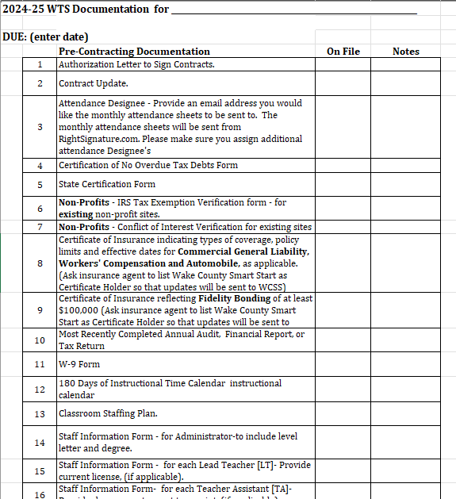
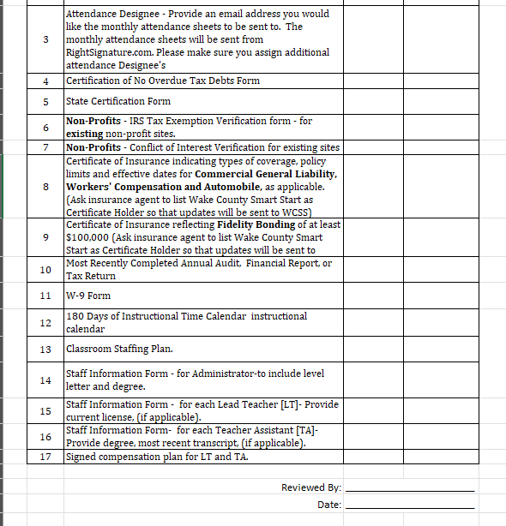
Pre-Contracting Forms
Forms Due by August 2nd by 5:00pm
180 School Days Calendar (for WTS children only) (if you are providing your own School Year Calendar)
Staff Information Form Administrator
Signed Compensation Plan for LT and TA
Classroom Staffing Plan
Contract Updates
Start and Ending Working Dates for Teacher & Teacher Assistant
Forms Due July 19th by 5:00pm
New Non-NC Pre K Sites Additional Pre-Contracting Forms:
Certificate of No Overdue Tax Debts Form
State Certificate Form
Non-Profits - IRS Tax Exemption Verification form - for existing non-profit sites
Non-Profits - Conflict of Interest Verification for existing sites
Certificate of Insurance indicating types of coverage, policy limits and effective dates for Commercial General Liability, Workers' Compensation and Automobile, as applicable. (Ask insurance agent to list Wake County Smart Start as Certificate Holder so that updates will be sent to WCSS)
Certificate of Insurance reflecting Fidelity Bonding of at least $100,000 (Ask insurance agent to list Wake County Smart Start as Certificate Holder so that updates will be sent to WCSS)
Most Recently Completed Annual Audit, Financial Report, or Tax Return
W-9 Form
Please note: All form are to be typed and sent electronically to Natasha Williams nwilliams@wakesmartstart.org by August 2, 2024, at 5:00pm.
The following forms will be completed via BridgeCare #2, #14, #15, 16 & 17.

Slide 55
Any Questions??
Thank You!

Slide 56


BridgeCare Workforce Development Training
1:00-1:45pm

